Slide 1



June 2024
JASON MULTI-AGENT SYSTEM FOR CITY SAFETY:
Agents Cooperating to Arrest Criminals
Multi-Agent Systems Course Final Project
Creative Project Classified as Hard
Giulia Benvenuto - 4678610

Slide 2
INTRODUCTION
Project Overview
The project utilizes Jason, an interpreter for AgentSpeak, to develop a Multi-Agent System that simulates a city environment.
In this environment, four types of agents are implemented, each exhibiting a different behavior. Police, civilian, and clue agents cooperate to detect and arrest criminal agents to ensure safety in the city.

Slide 3
PROBLEM STATEMENT
City Safety Problem
Safety is a key issue in city areas, affecting the happiness of the residents. Thus, it’s reasonable to think that civilians living in the city will collaborate with police to enhance their personal safety and contribute to the overall security of the environment.
Why a multi-agent system is suited for this problem
MAS aligns well with the City Safety Problem due to its ability to manage complex interactions among multiple agents who cooperatively work toward the common goal of ensuring city safety by arresting criminals.

Slide 4
DEVELOPMENT FRAMEWORK
Jason
Jason is an interpreter for an extended version of AgentSpeak.
It is crucial in the project for defining and managing the behavior of the agents (police, civilian, clue, and criminals) making them able to dynamically interact basing on their beliefs, desires and intentions.
Java
Enhances Jason capabilities with the possibility of integrate and extend functionalities of the MAS. Allows for the dynamic addition of percepts to agents as they navigate the city environment, and supports the development of core system components (CityEnvironment, CityModel and CityView java classes), of internal actions and visual representation of the environement.

Slide 5
ENVIRONMENT (1)
Simulated City Environment
The City Environment in the MAS serves as the dynamic stage where agents perform their roles and interact. It is implemented through a structured architecture that involves the use of three Java classes that exted Jason classes:
CityEnvironment.java → extends Jason.environment.Environment
CityModel.java → extends GridWorldModel
CityView.java → extends GridWorldView

Slide 6
ENVIRONMENT (2)
CityEnvironment.java
Initialize the city simulation environment where agents interact and navigate. Handles the movement of police agents icon step after step.
CityModel.java
Responsible for creating and managing the state of the 40x40 city grid, it handles both dynamic and static entities within the environment.
CityView.java
Responsible for the visual representation of the city environment, including drawing icons of obstacles and agents. Also, handles updates in response to changes within the model.

Slide 7
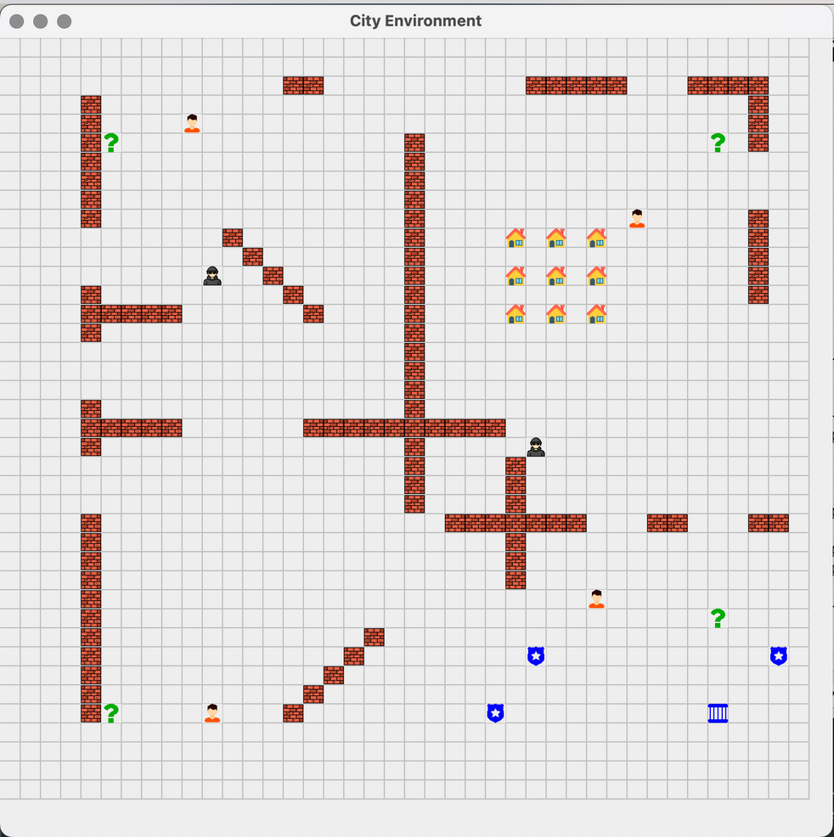










ENVIRONMENT (3)
City Environment Result
Wall Obstacle
Police Agent
House Obstacle
Police Agent Escorting
Jail
Civilian Agent
One criminal in jail
Clue Agent
Two criminals in jail
Criminal Agent

Slide 8
AGENTS (1)
Behavior of Police Agents
Three police agents.
Complex and dynamic position.
Navigate the city following the shortest path computed with the A* algorithm.
At each step, look around the 8 neighboring cells.
If they find a civilian agent take the clue position (X, Y) from it and next move there.
If they find a clue agent collect the X or Y of a criminal.
If both X and Y of a criminal has been found, they move there.
If they find a criminal, arrests him, escort him to the jail and broadcast other agents that a criminal has been arrested.
Police Agent Icon
Police Agent Icon while Escorting

Slide 9
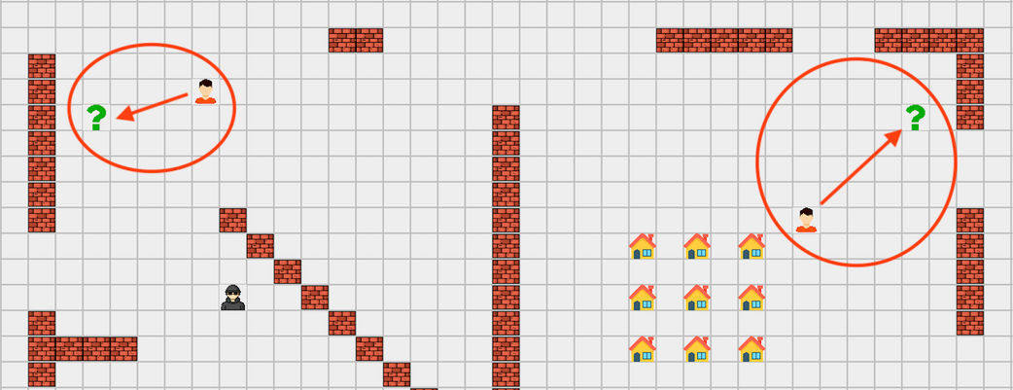
AGENTS (2)
Behavior of Civilian Agents
Four civilian agents.
Static position.
If they are found by a police agent, communicate to him the position
(X, Y) of their closest clue.
If they receive a broadcast message from a police agent about the arrest of a criminal they respond with a message thanking him.
Civilian Agent Icon

Slide 10
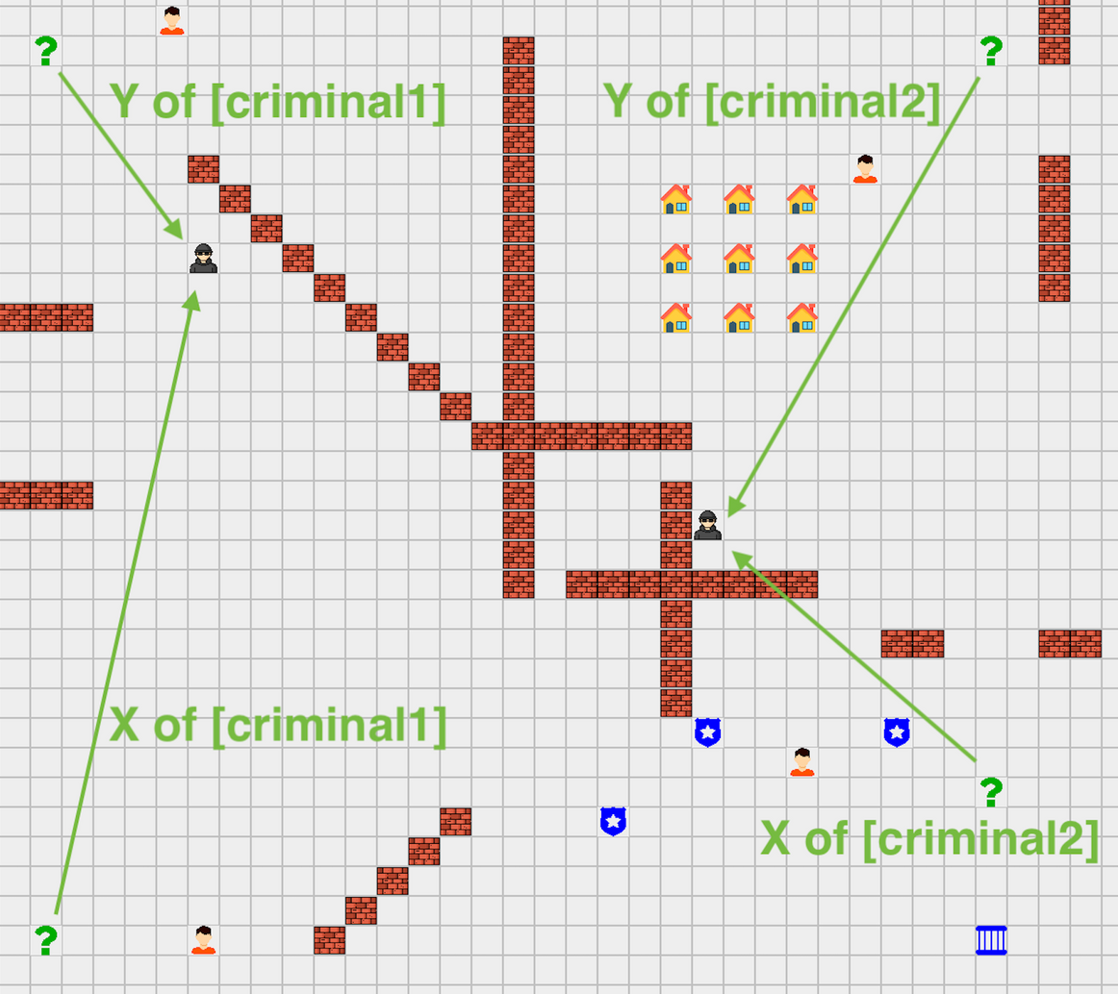
AGENTS (3)
Behavior of Clue Agents
Four clue agents.
Static position.
If they are found by a police agent, communicate to him the known X or Y coordinate and the ID of the criminal.
Clue Agent Icon

Slide 11
AGENTS (4)
Behavior of Criminal Agents
Two criminal agents.
Static position.
They hide in the city and upon being discovered, they receive a message from the police agent declaring that they are under arrest.
When arrested by a police agent, they are removed from the grid as they are escorted to jail.
Criminal Agent Icon

Slide 12
INTERNAL ACTIONS (1)
What are Internal Actions?
Internal Actions are used in the project as a building block for agents to perform operations that go beyond basic logical reasoning.
To develop an Internal Action, one must extend a java class with the “DefaultInternalAction” class provided by Jason.
This approach allows the implementation of specific agent behaviors.

Slide 13
INTERNAL ACTIONS
1) FindPath.java
Handles the logic of finding a path between two locations (x, y) in the city grid. Used by police agents in the “explore” goal.
2) Escorting.java
Handles the escorting logic for the police agents. It activates the escorting state to true when a police agent arrest a criminal, updating to the police agent’s icon.
3) EnterJail.java
Manages a police agent's entry into jail with a criminal, including removing the agent's icon from the grid to indicate they are inside.
4) Arrested.java
Handles the logic to arrest a criminal which involves removing the criminal’s icon from the grid when a police agent finds and arrest him.

Slide 14
UTILITY AND HELPER CLASSES
1) AgentIdMapper.java
Maps agent IDs from Java to Jason since they have a different numbering systems: Java IDs range from 0 to 12, while Jason IDs span from 0 to one less than the total agent instances.
2) AgentPercept.java
Adds and updates the agents’ beliefs, so it acts as the intermediary layer between the agent representation in Java and Jason.
3) LookAround.java
Used by police agents at each step to detect the presence of other agents, obstacles or jail in the eight neighboring cells around their current position.

Slide 15
Thank You

